Slide 1
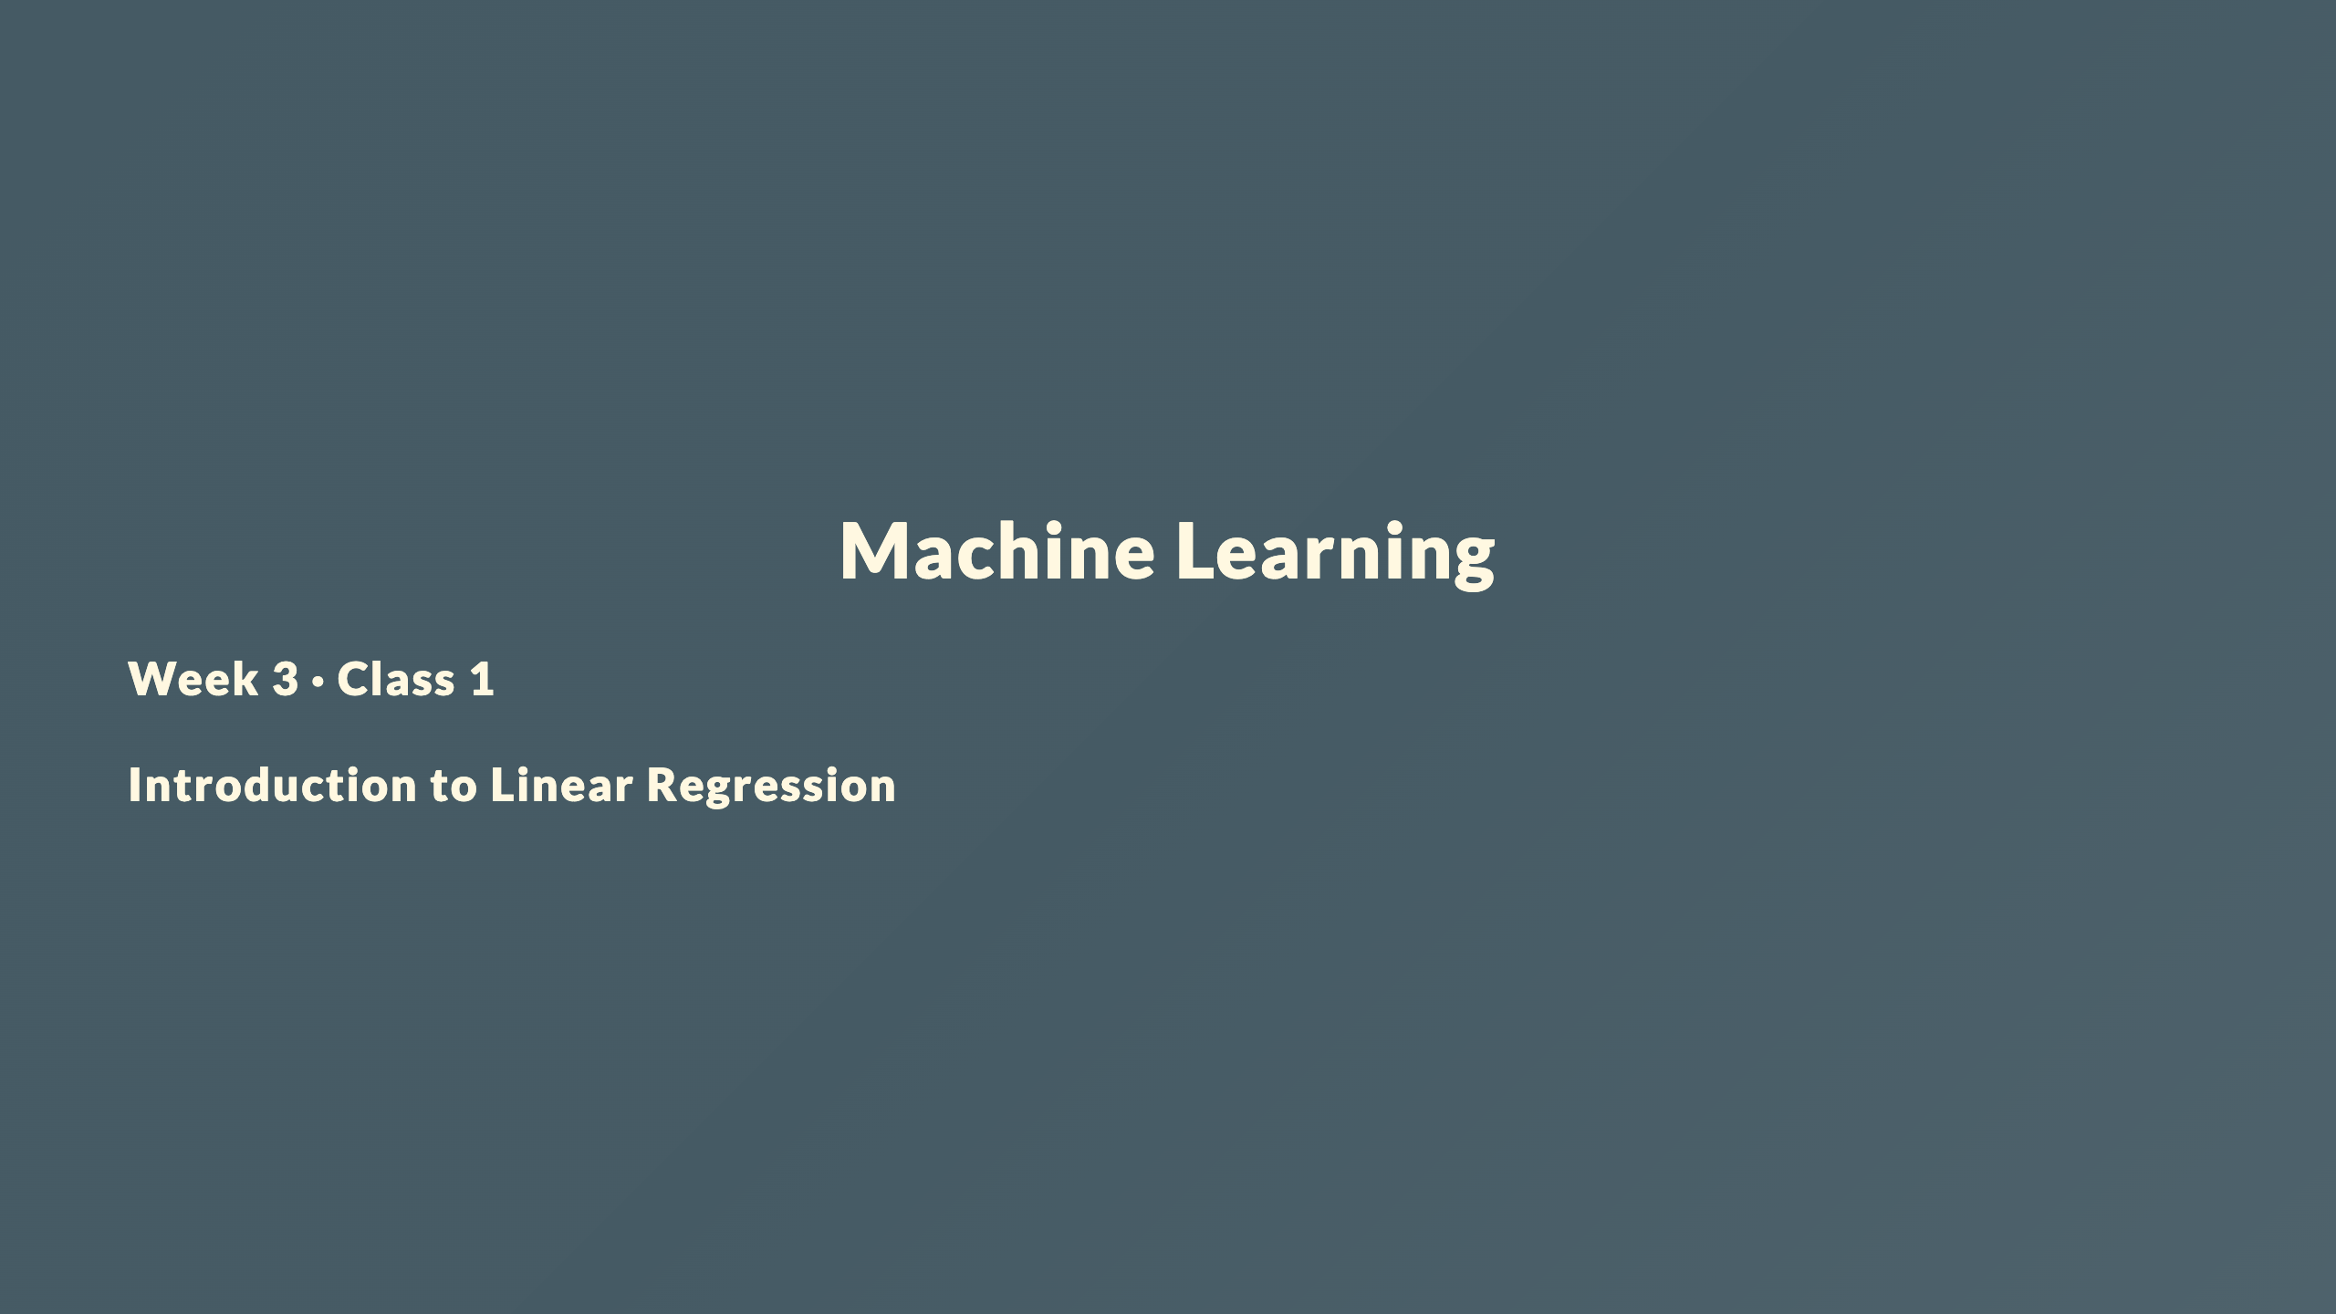

Slide 2
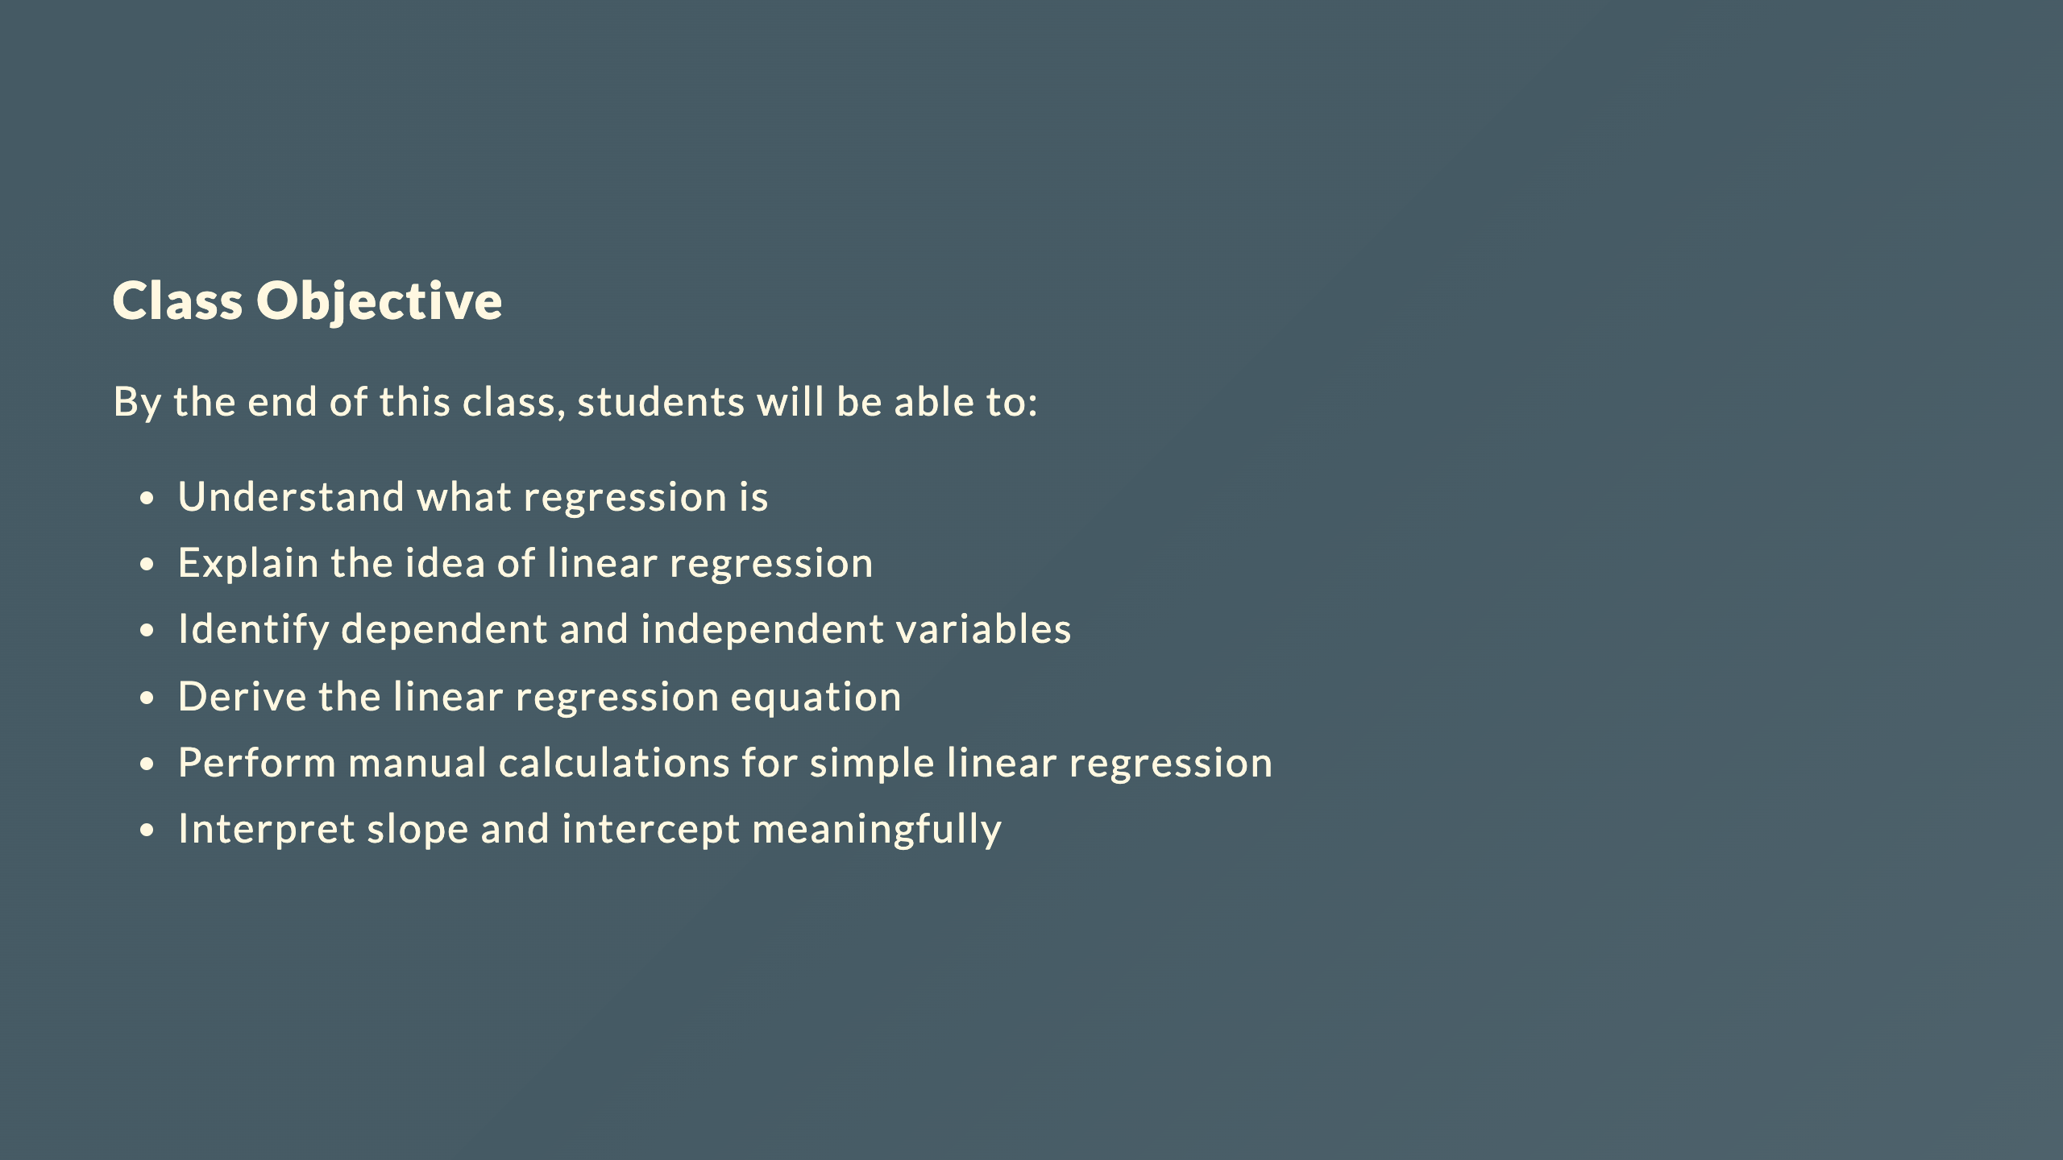

Slide 3
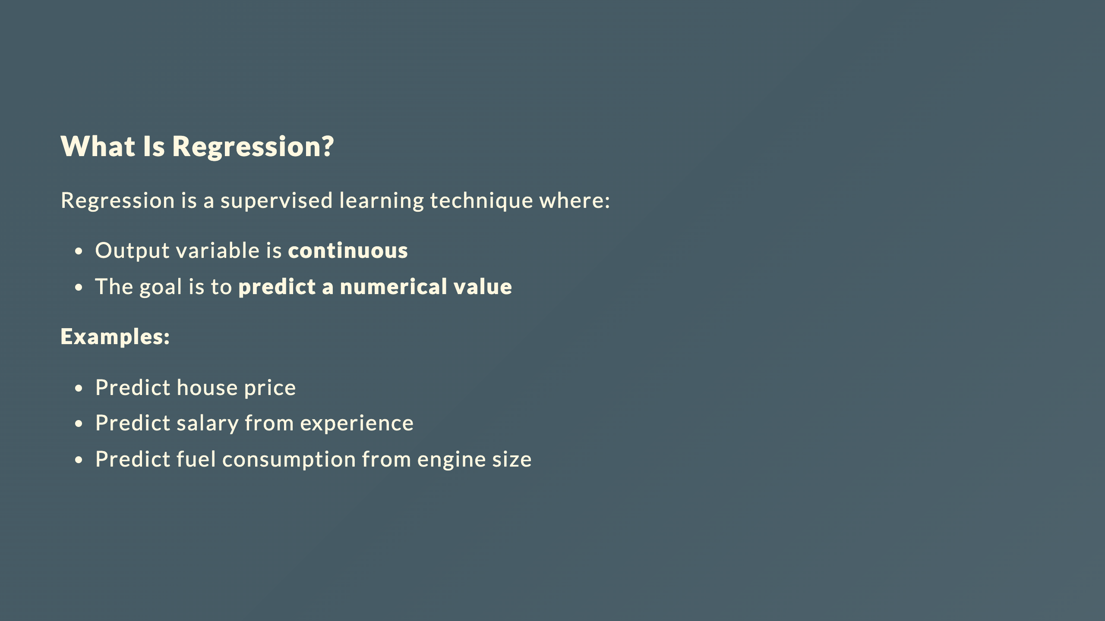

Slide 4
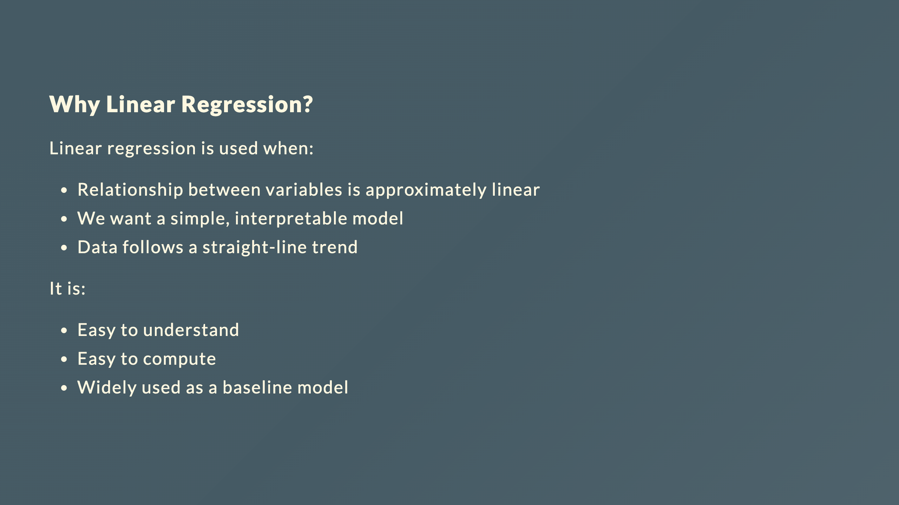

Slide 5
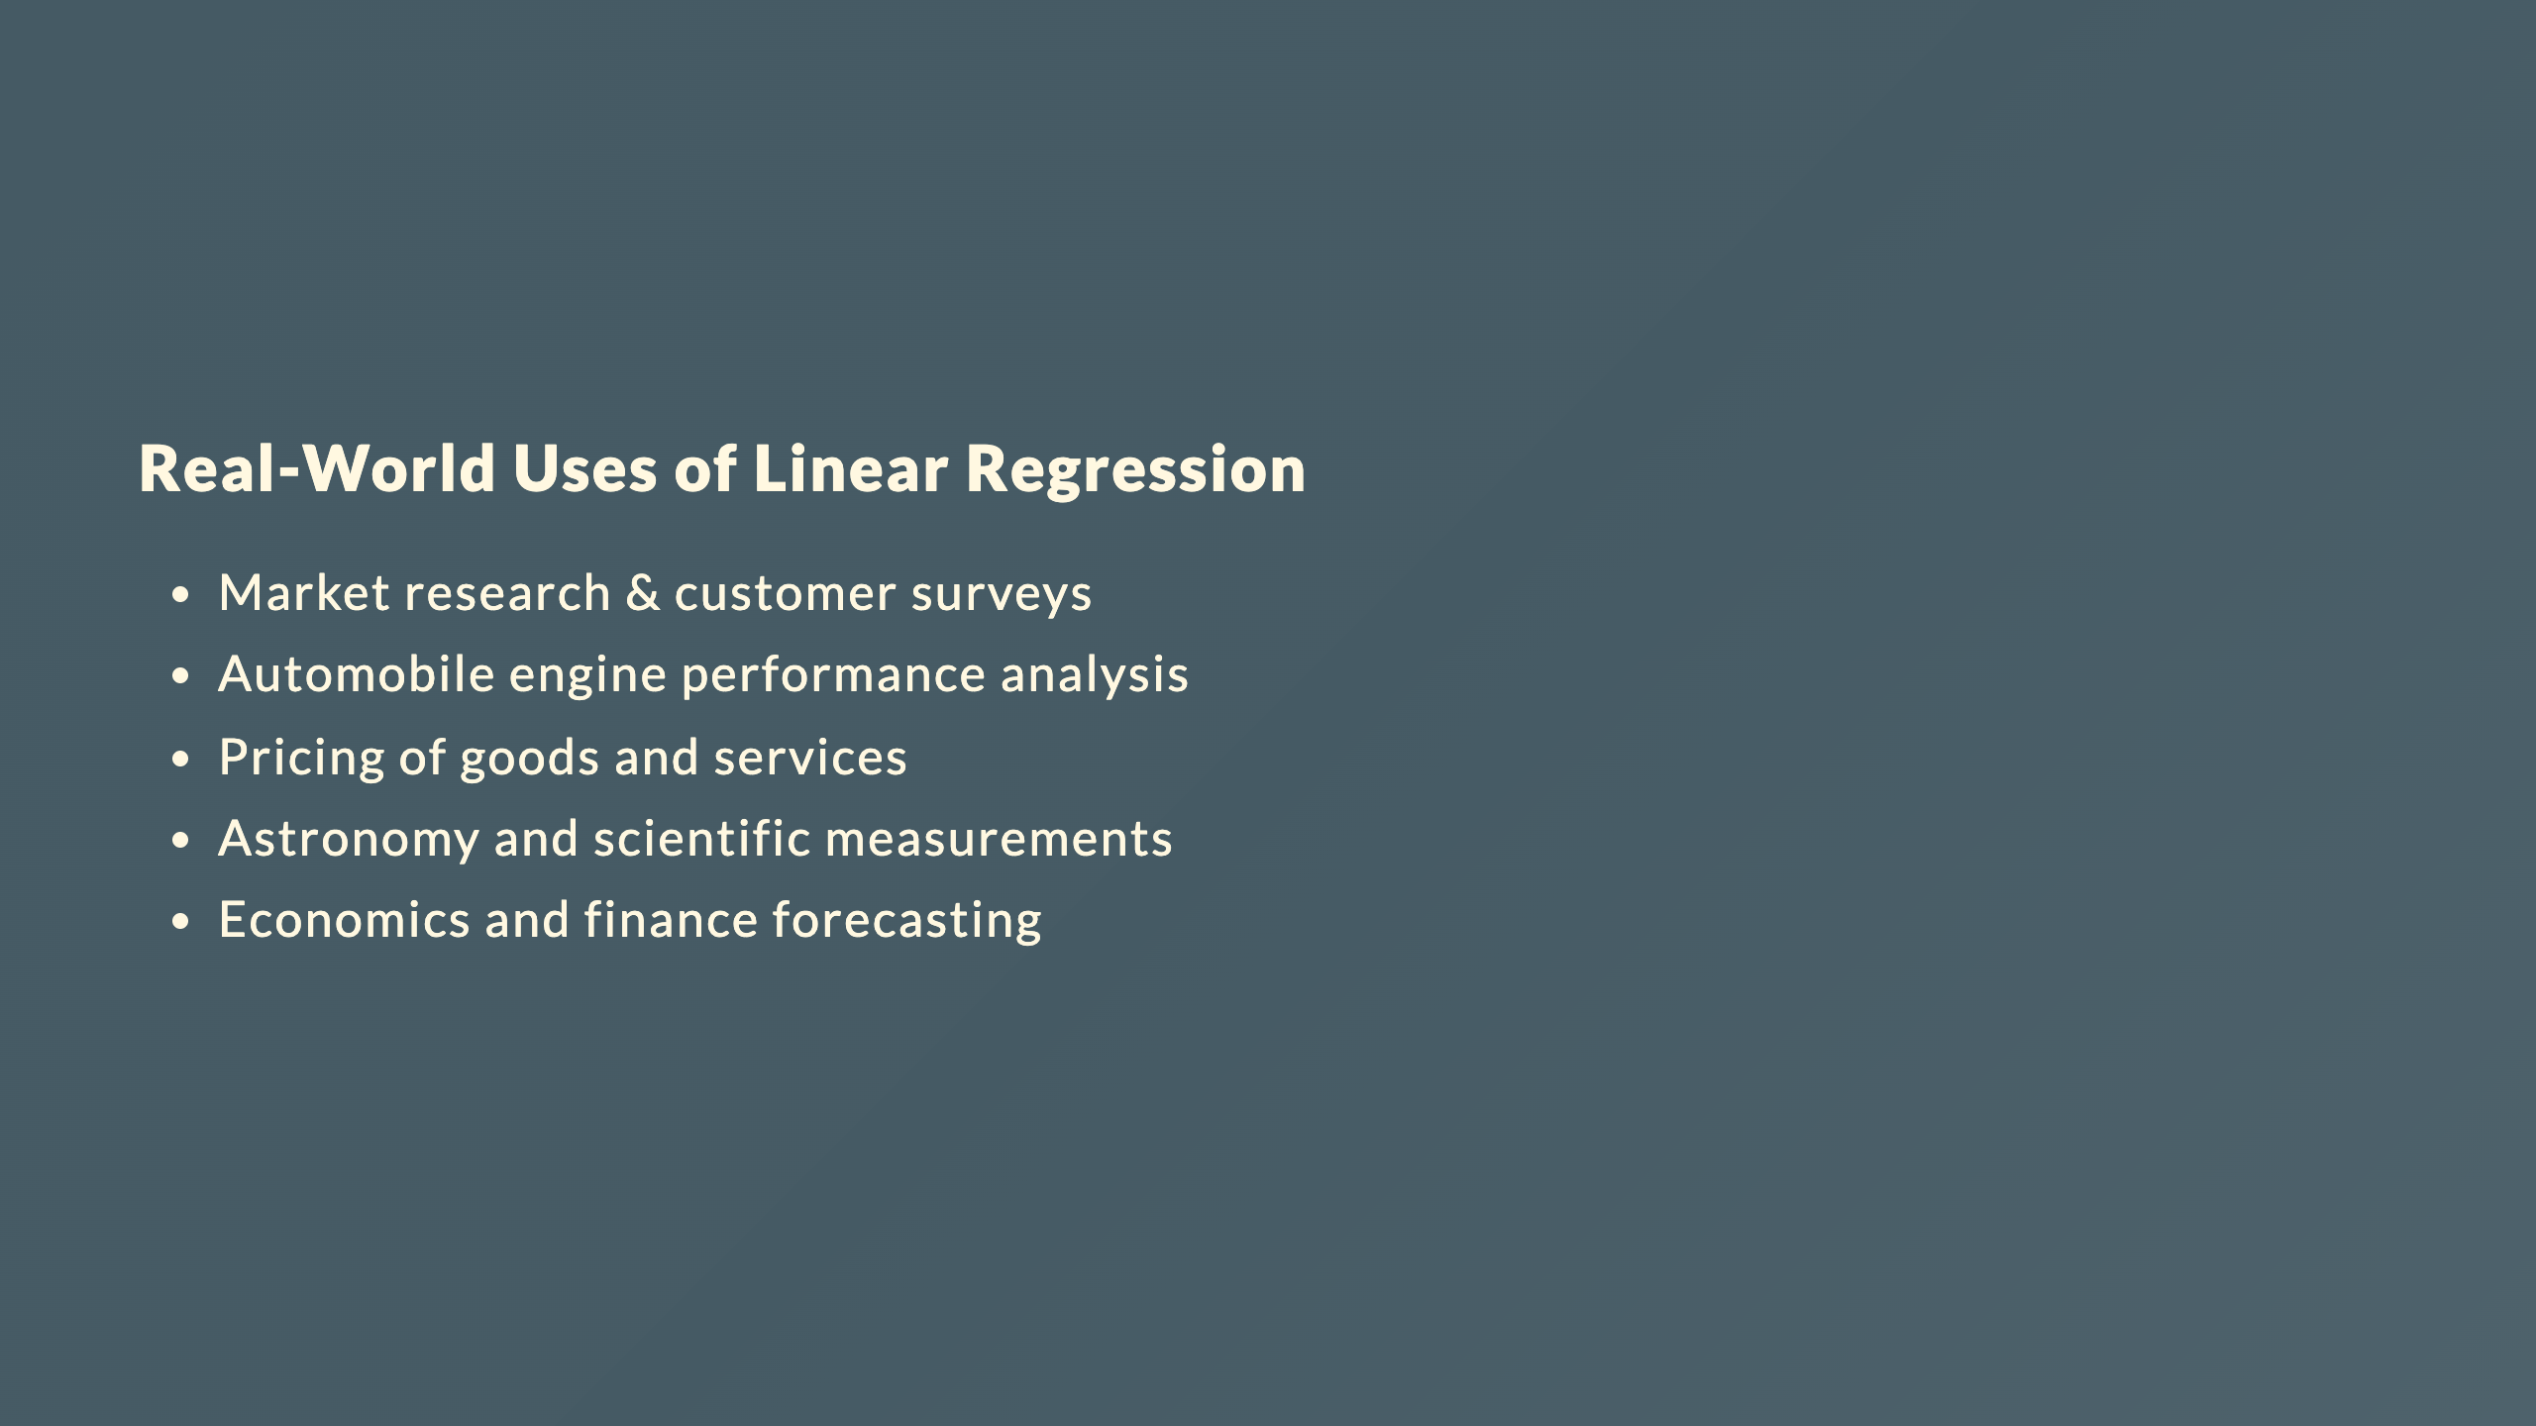

Slide 6
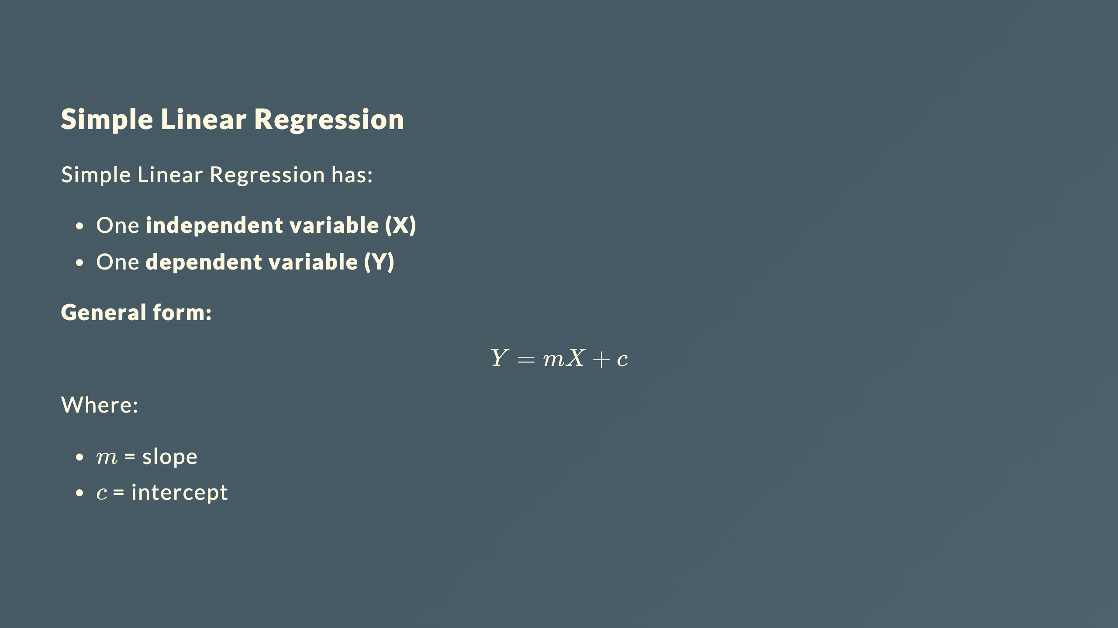

Slide 7
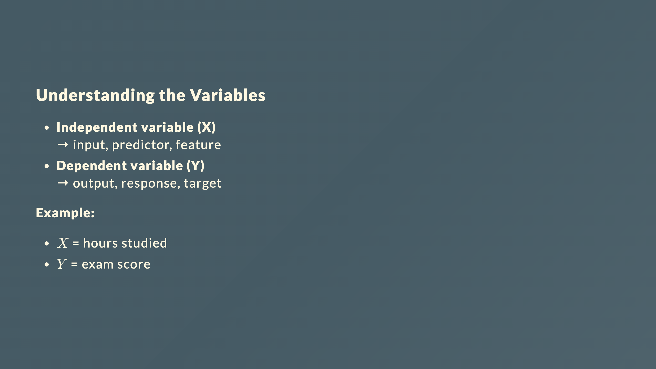

Slide 8
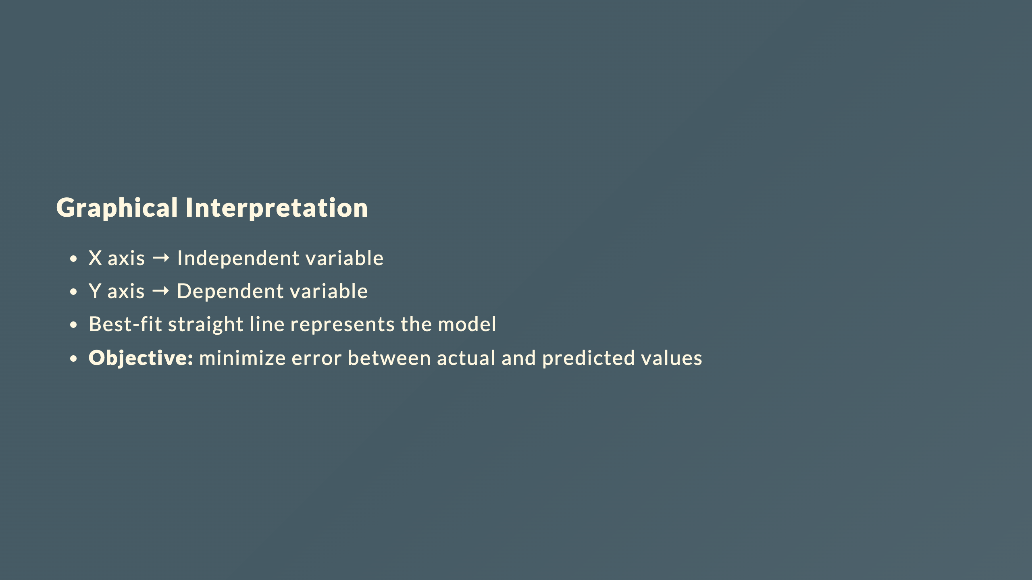

Slide 9
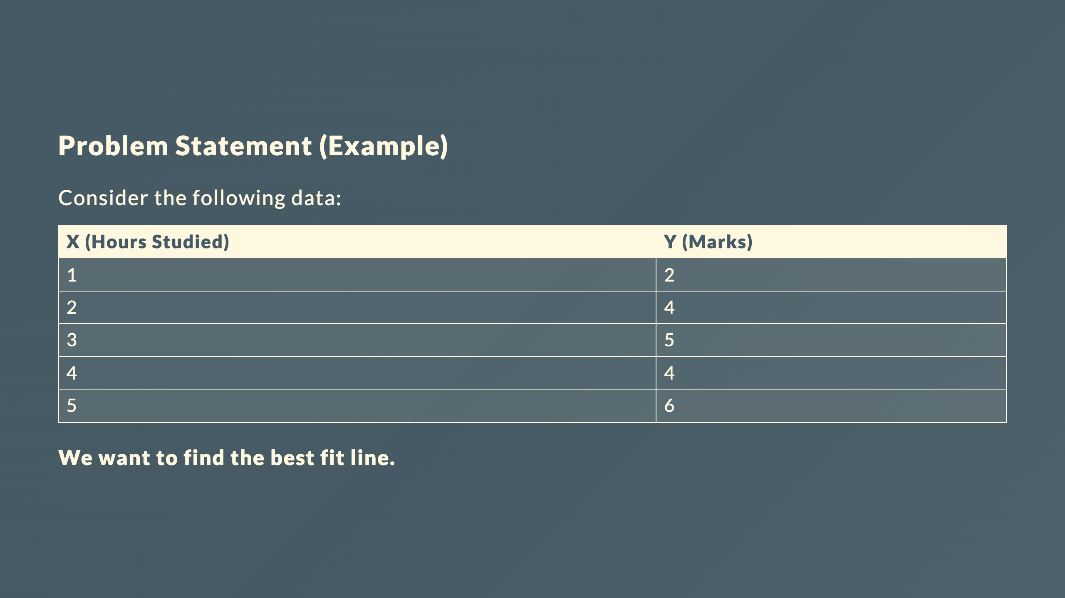

Slide 10
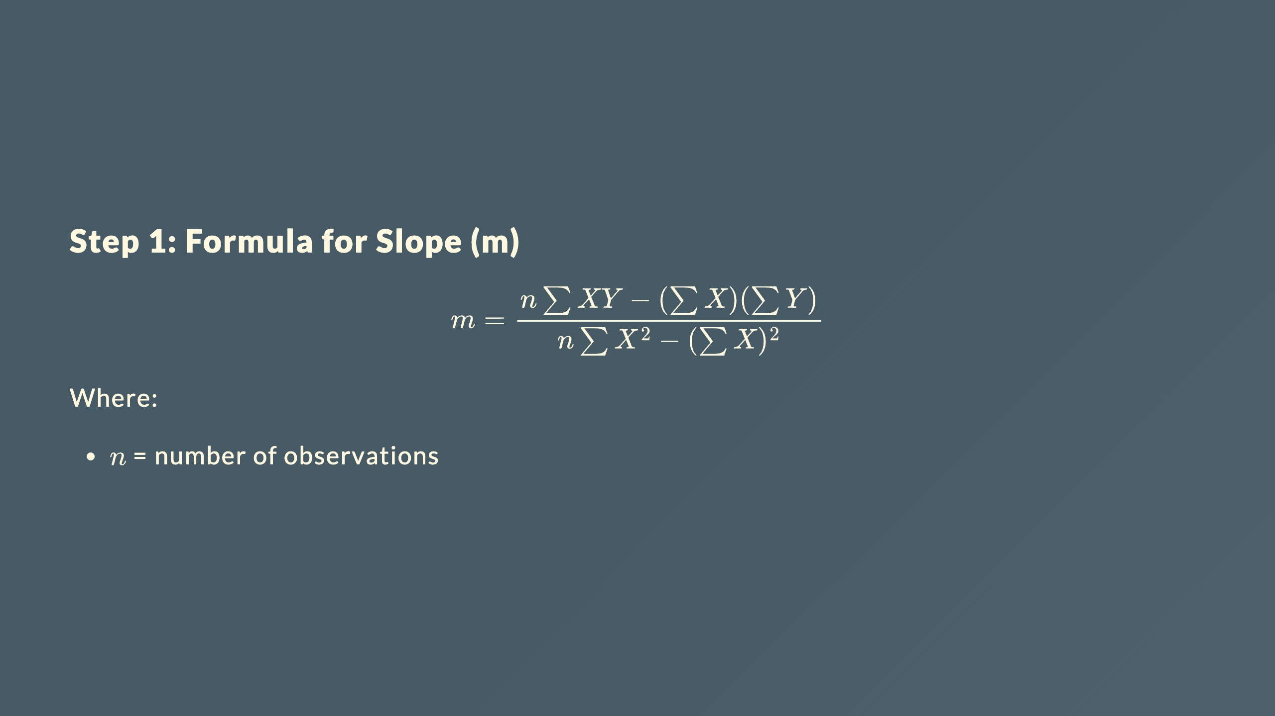

Slide 11
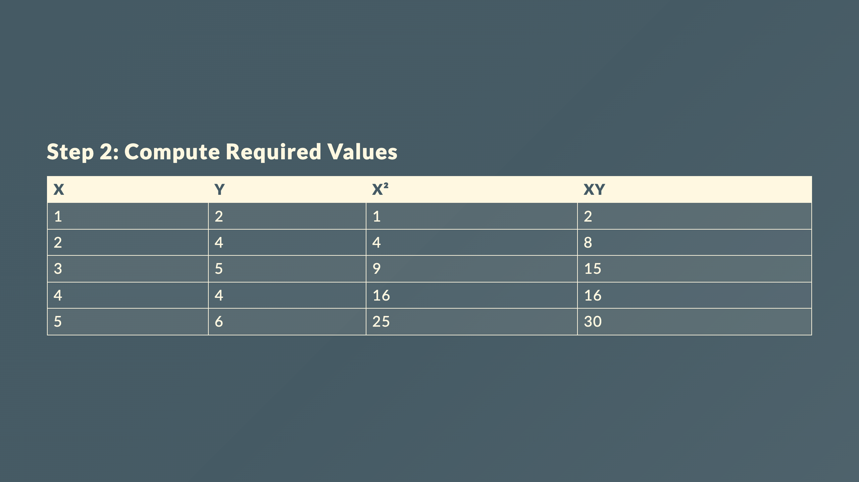

Slide 12
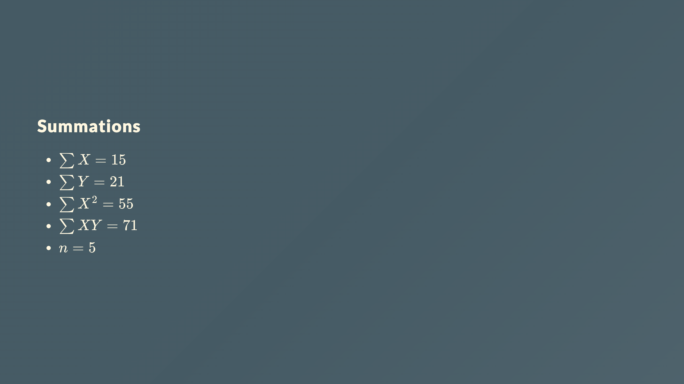

Slide 13
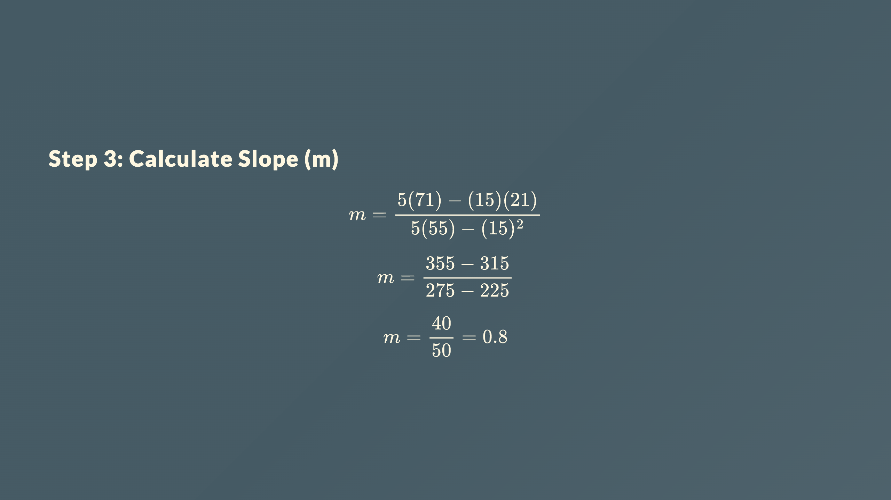

Slide 14
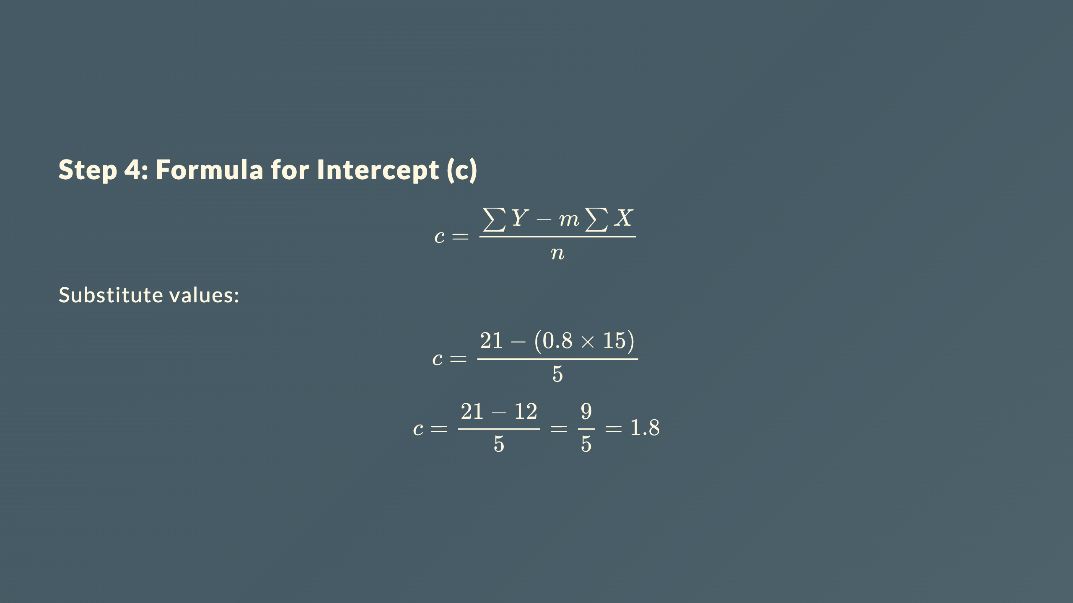

Slide 15
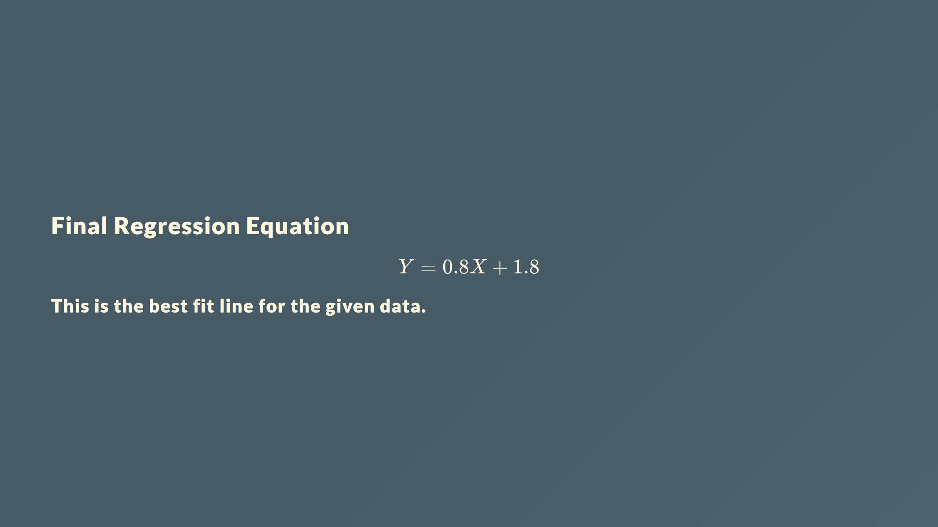

Slide 16
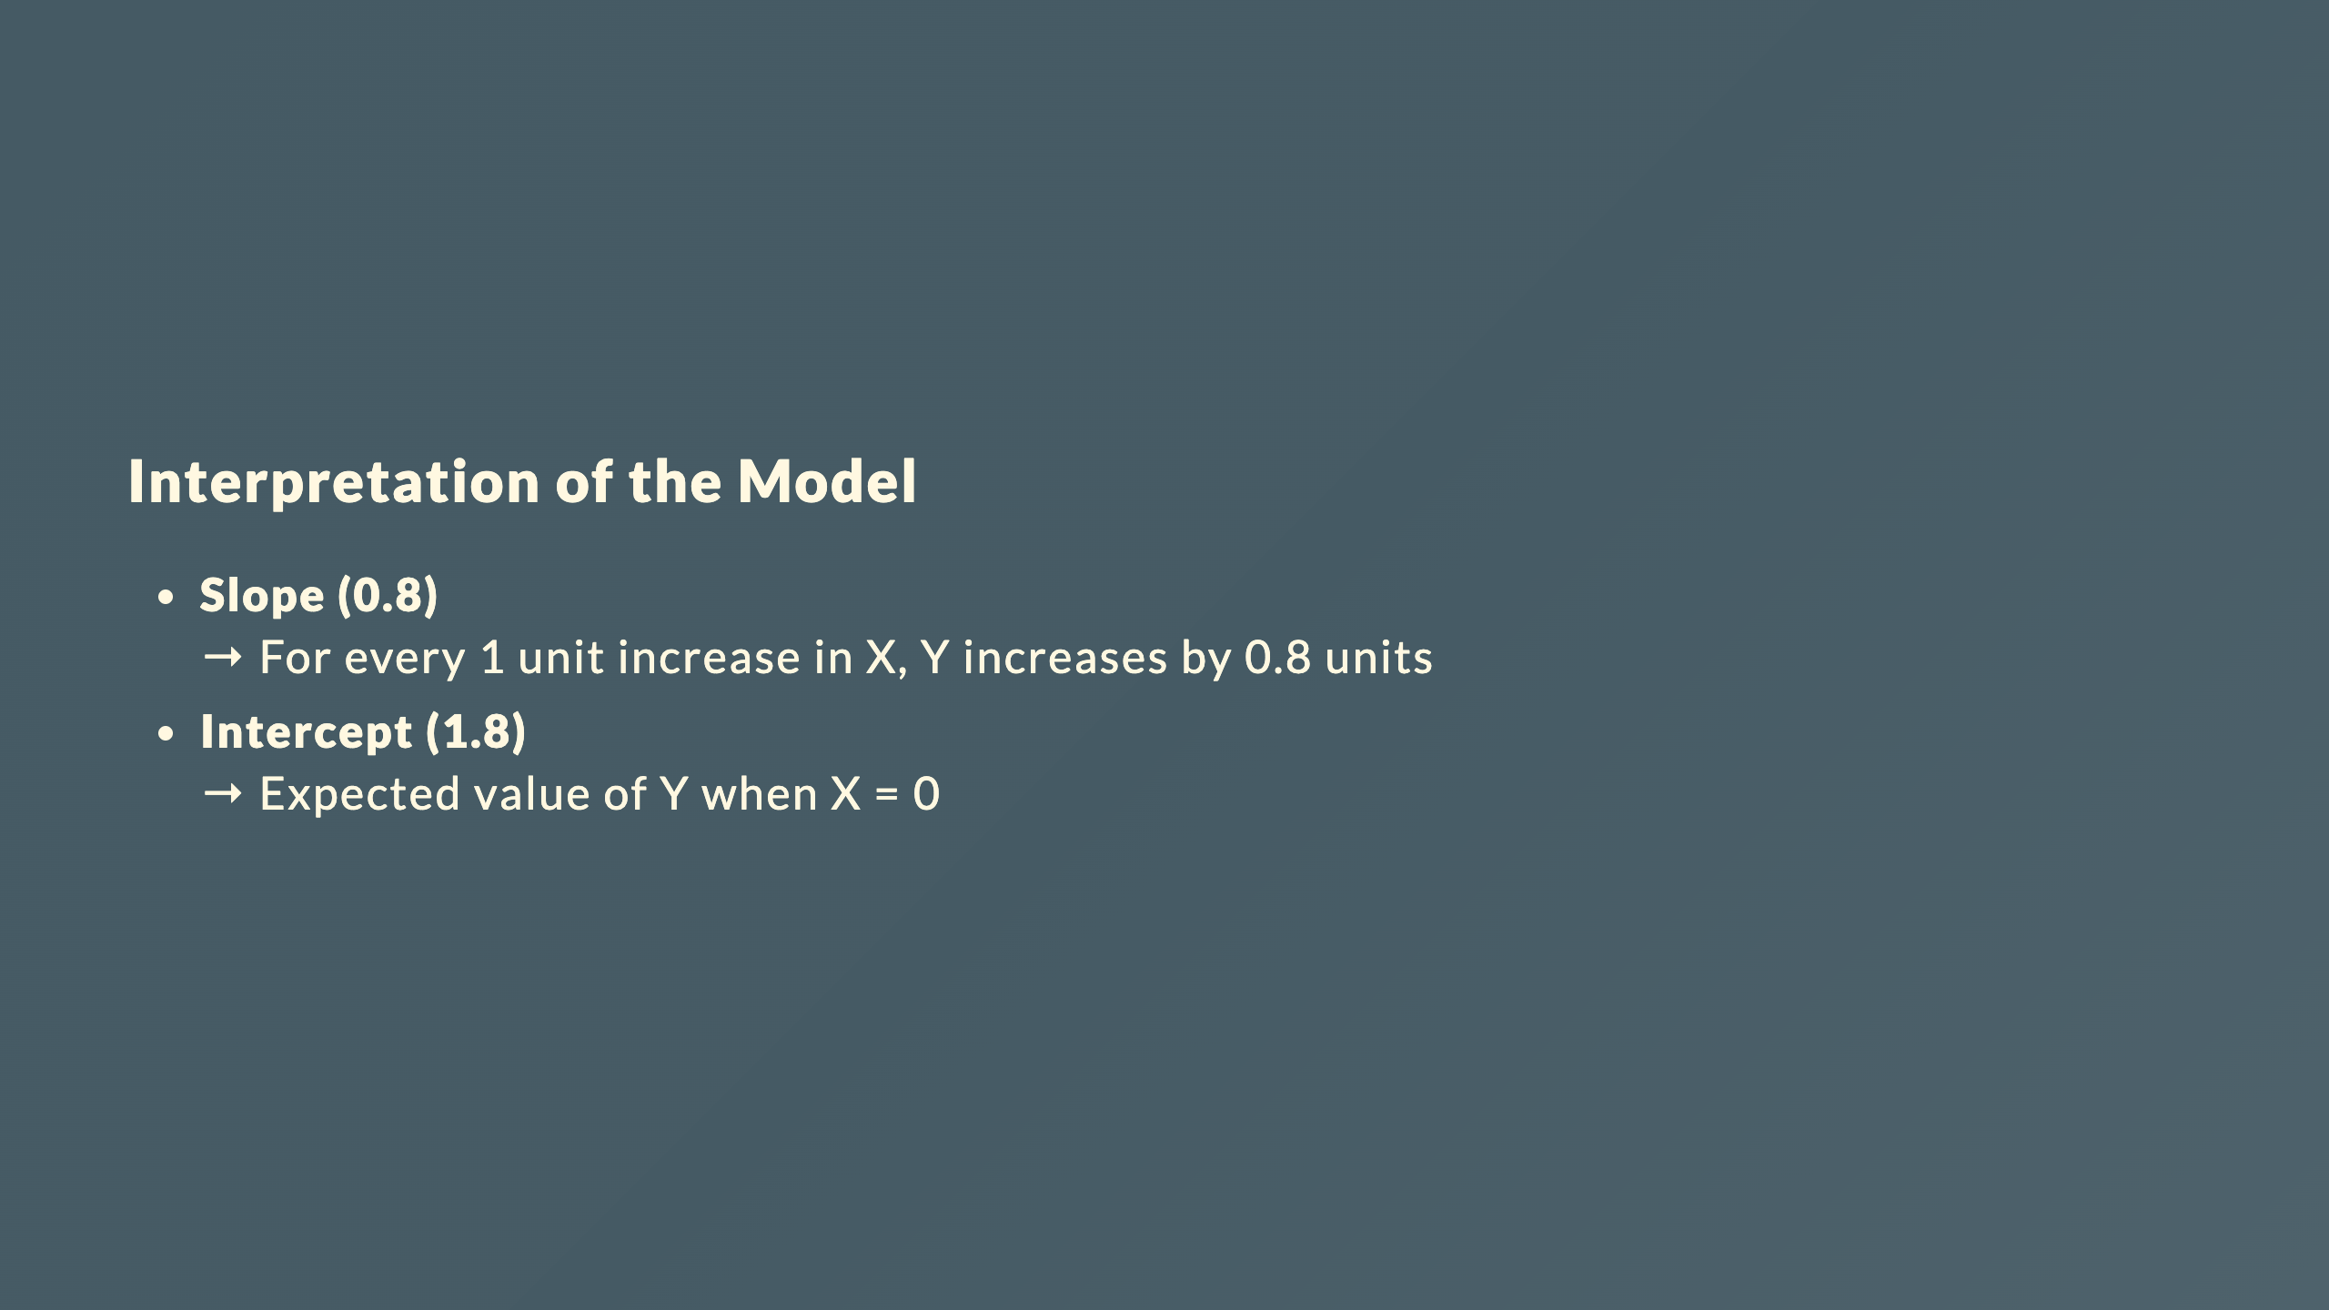

Slide 17
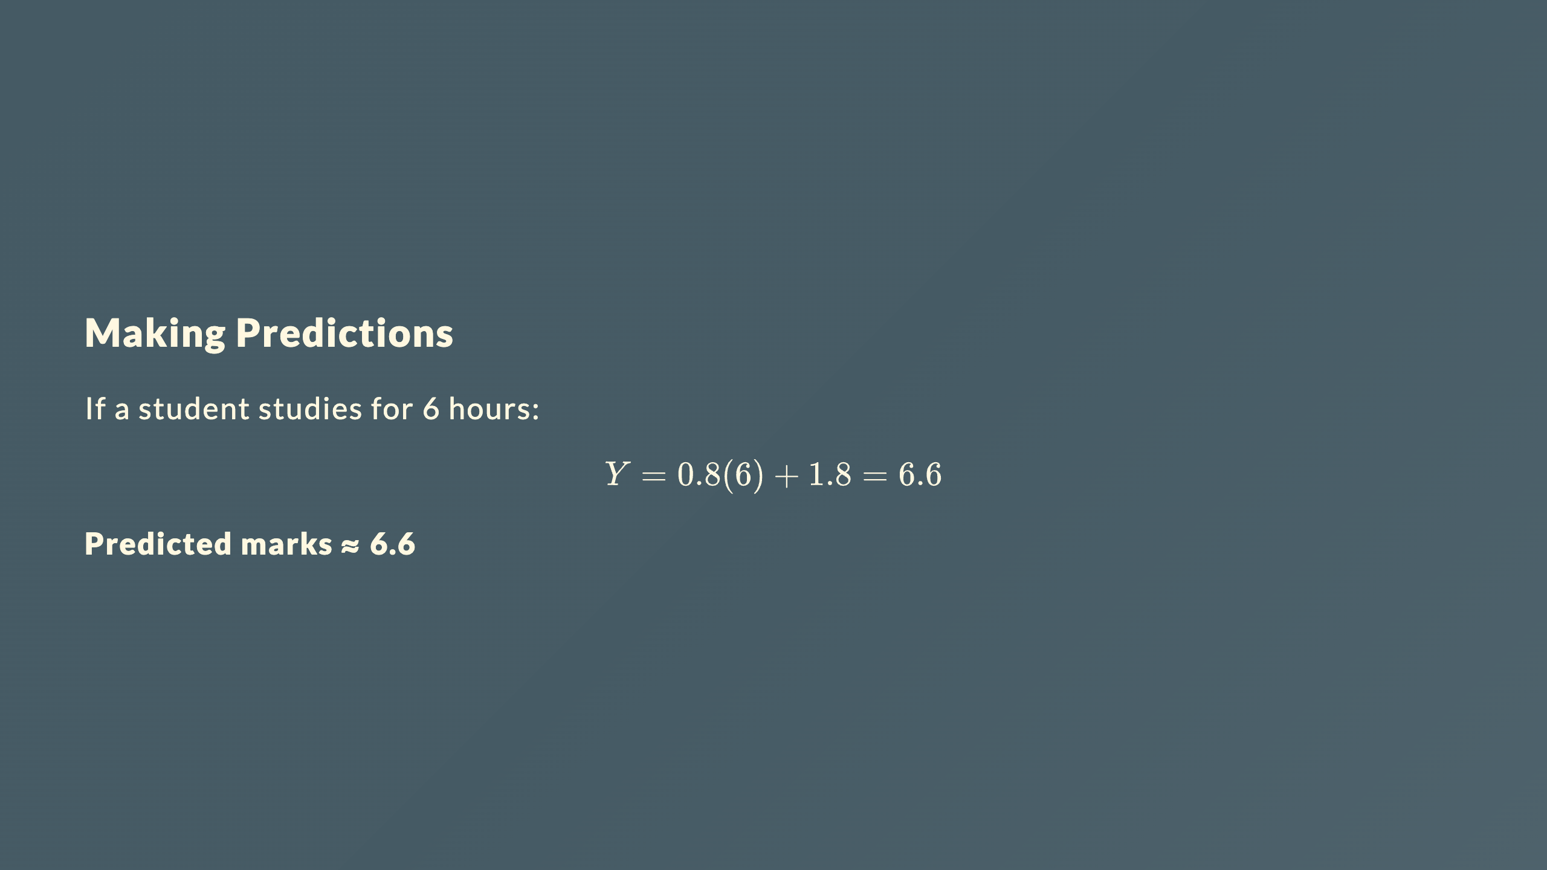

Slide 18
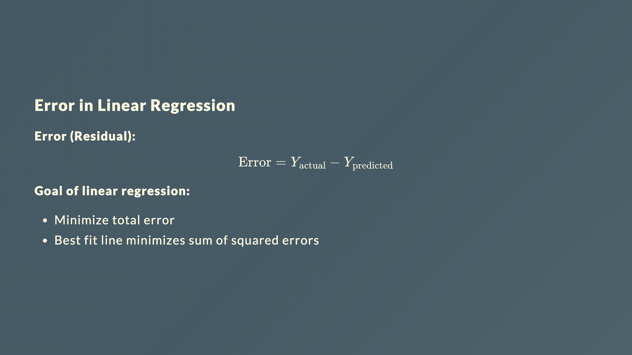

Slide 19
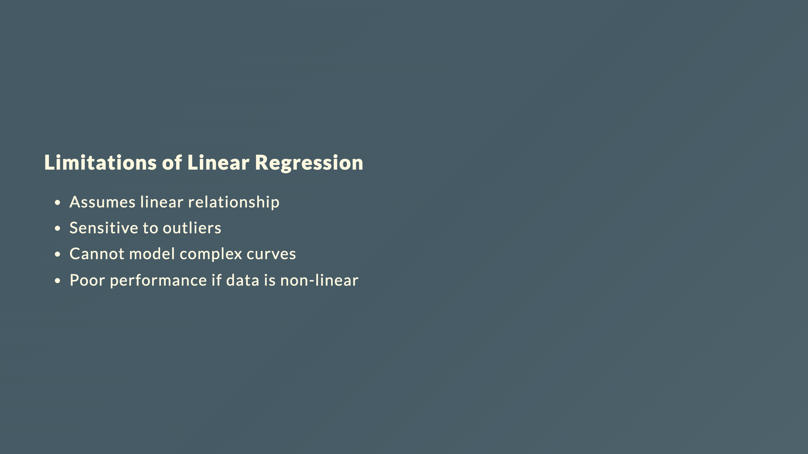

Slide 20
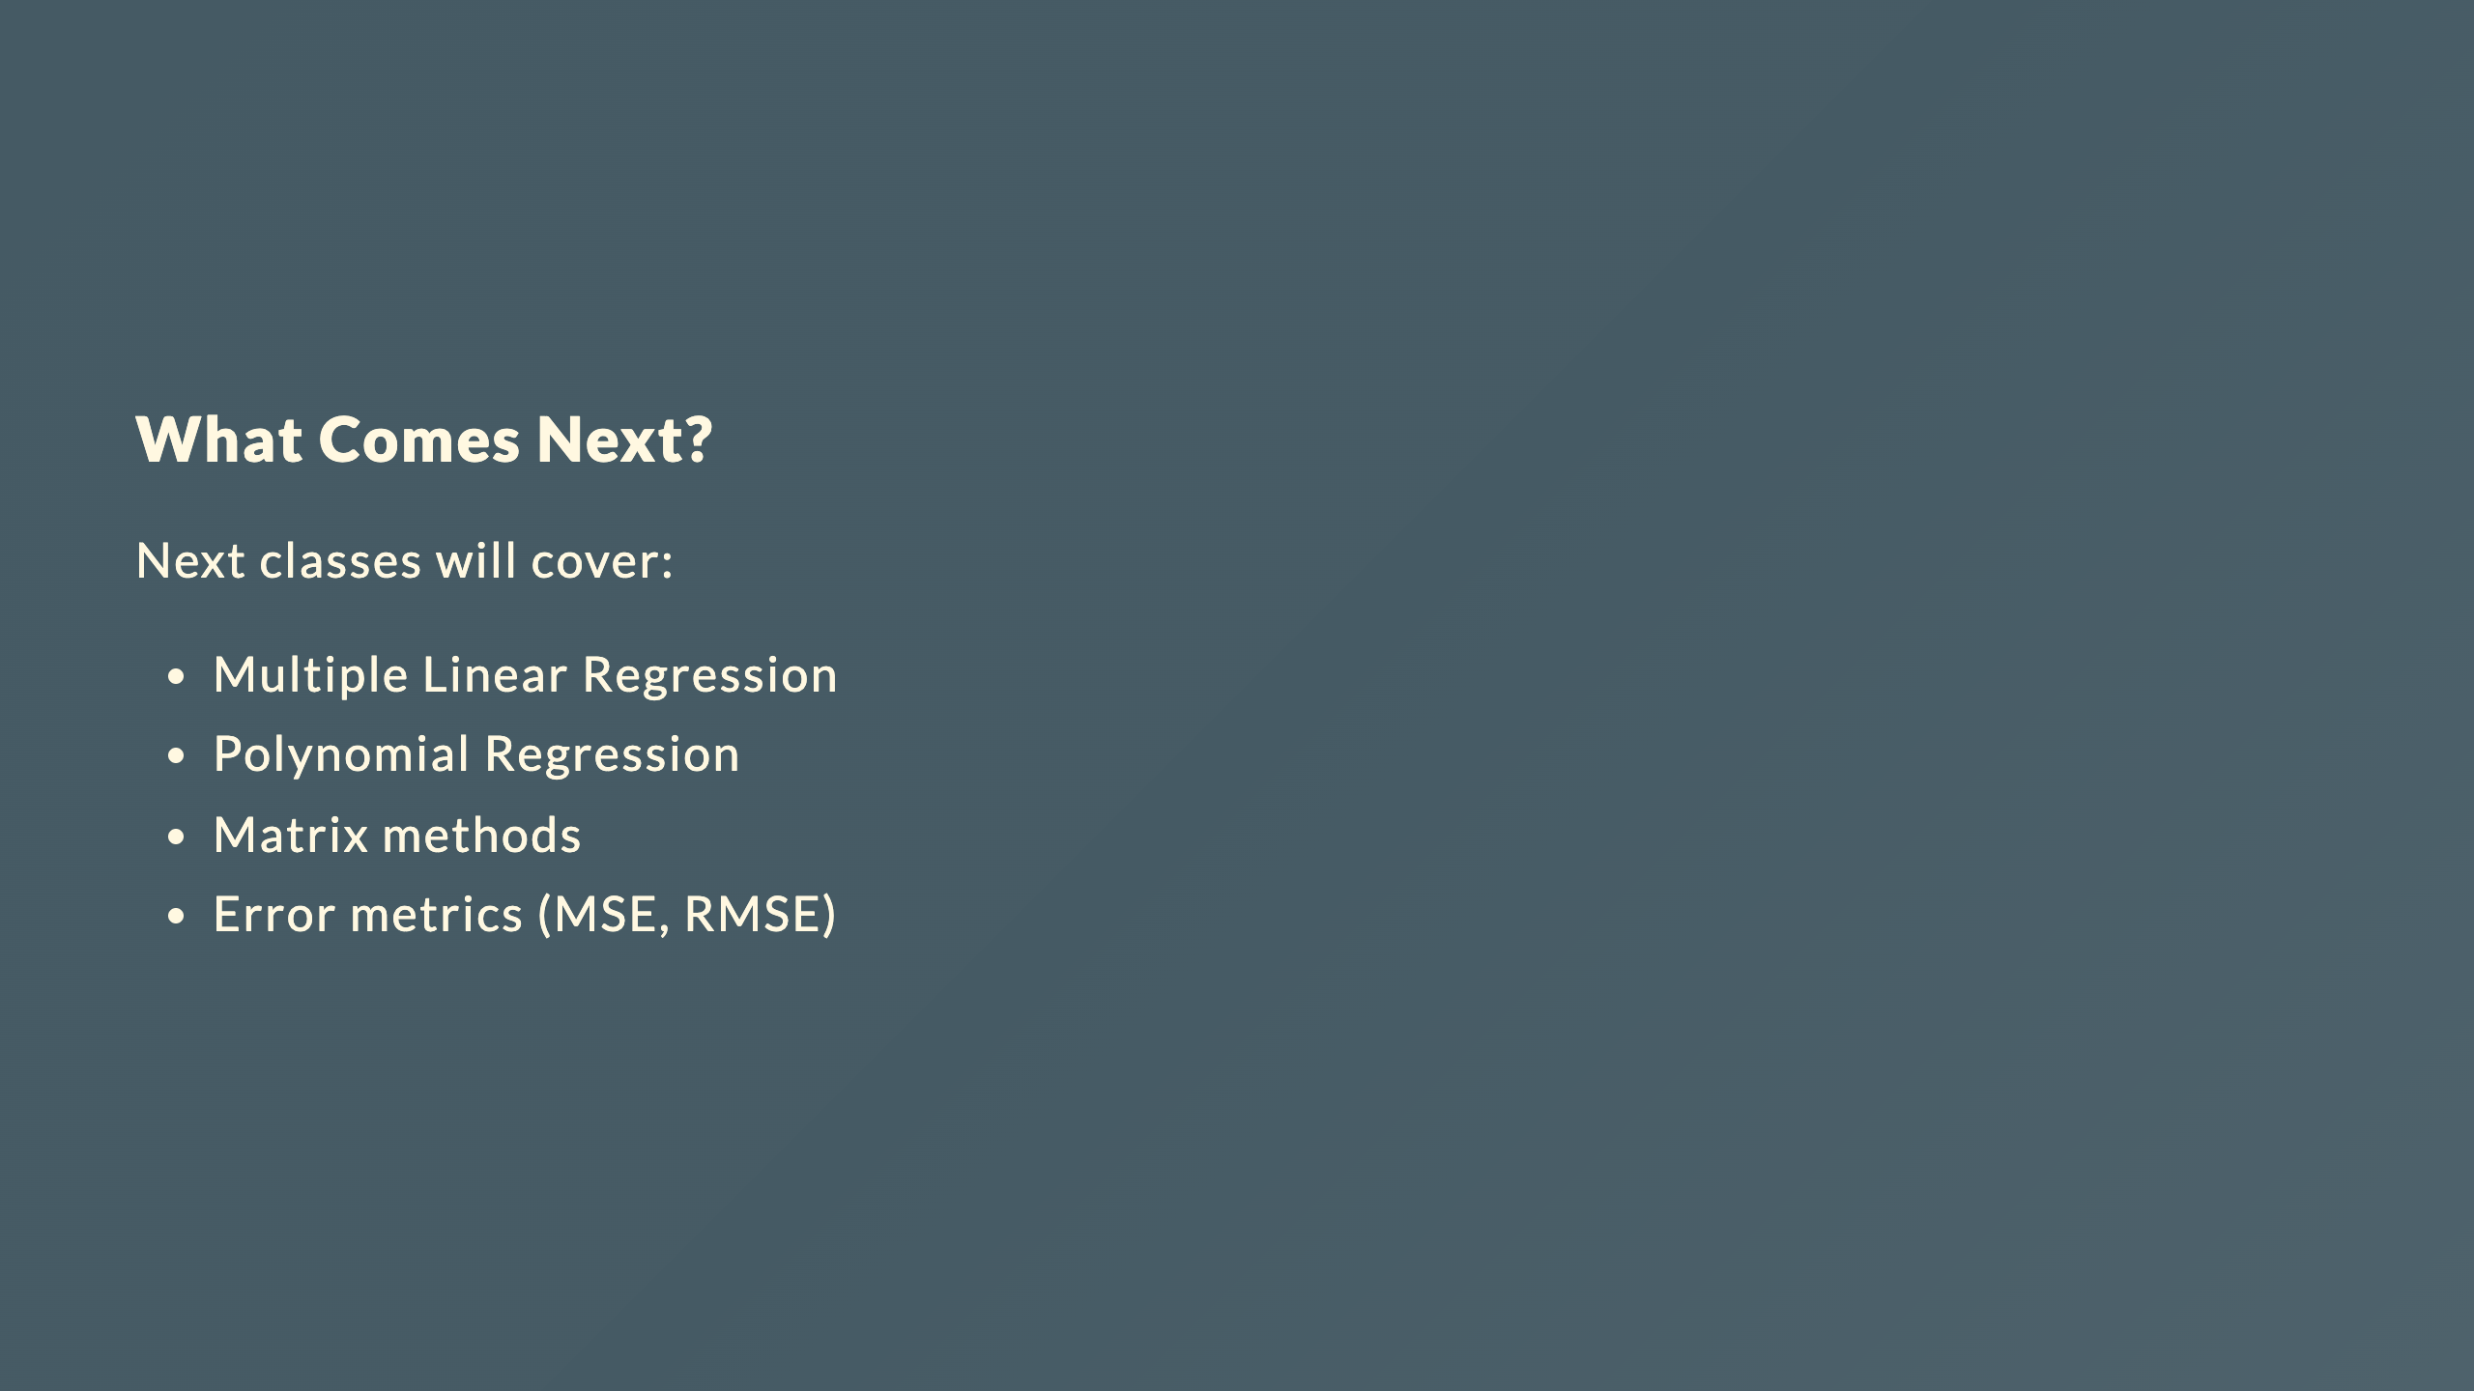

Slide 21
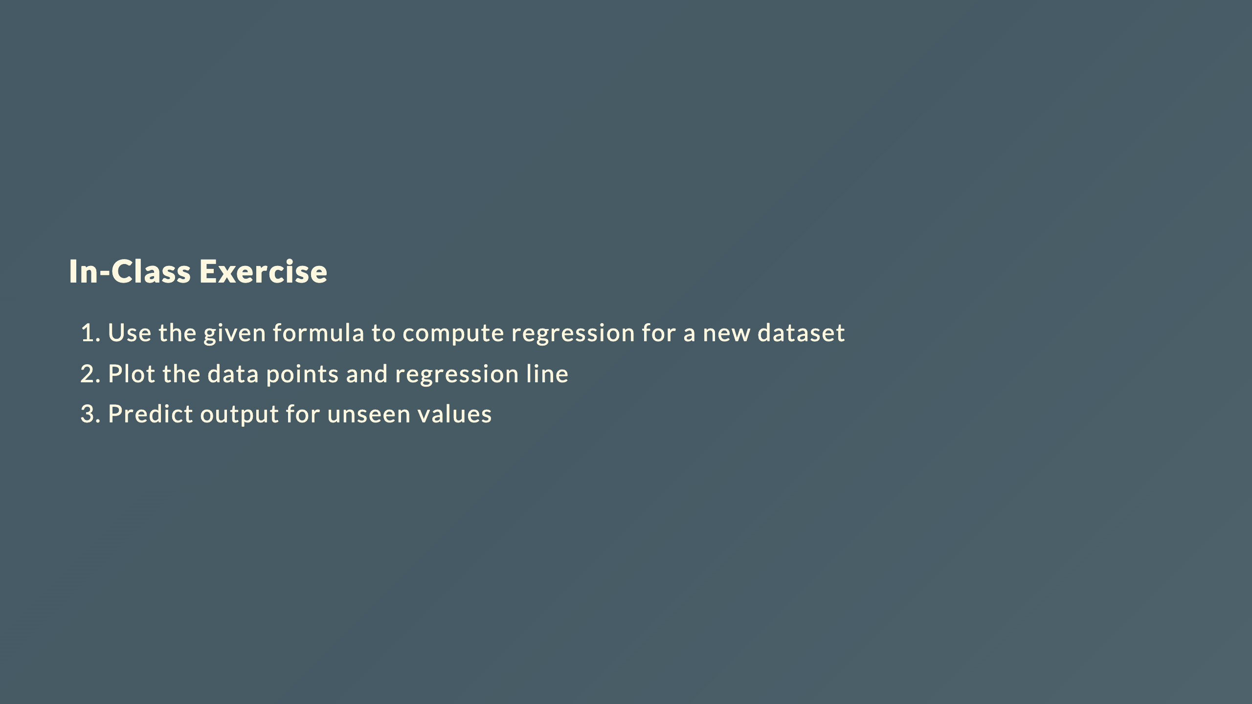

Slide 22
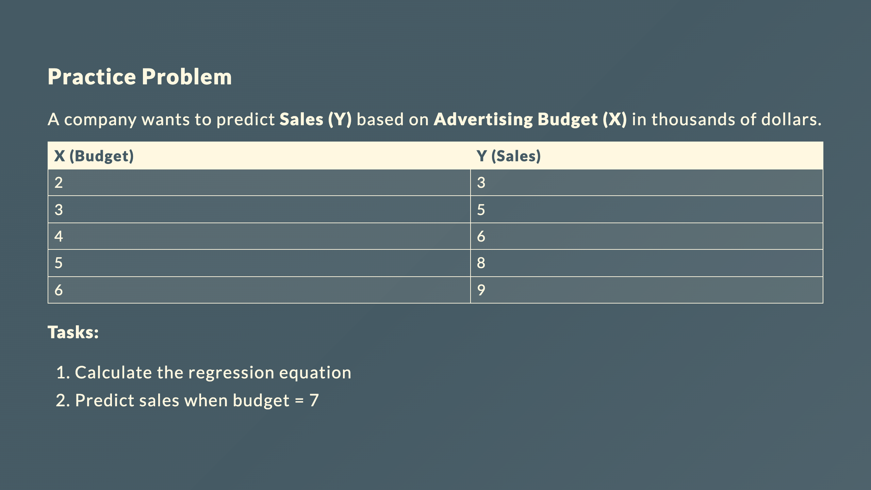
Notes:
SOLUTION: Step 1: Create computation table X Y X² XY 2 3 4 6 3 5 9 15 4 6 16 24 5 8 25 40 6 9 36 54 Step 2: Calculate summations ∑X = 20 ∑Y = 31 ∑X² = 90 ∑XY = 139 n = 5 Step 3: Calculate slope (m) m = [n∑XY - (∑X)(∑Y)] / [n∑X² - (∑X)²] m = [5(139) - (20)(31)] / [5(90) - (20)²] m = [695 - 620] / [450 - 400] m = 75 / 50 m = 1.5 Step 4: Calculate intercept (c) c = [∑Y - m∑X] / n c = [31 - (1.5 × 20)] / 5 c = [31 - 30] / 5 c = 1 / 5 c = 0.2 Step 5: Regression equation Y = 1.5X + 0.2 Step 6: Prediction for X = 7 Y = 1.5(7) + 0.2 Y = 10.5 + 0.2 Y = 10.7 Answer: Expected sales ≈ 10.7 thousand dollars (or $10,700)

